Slide 1
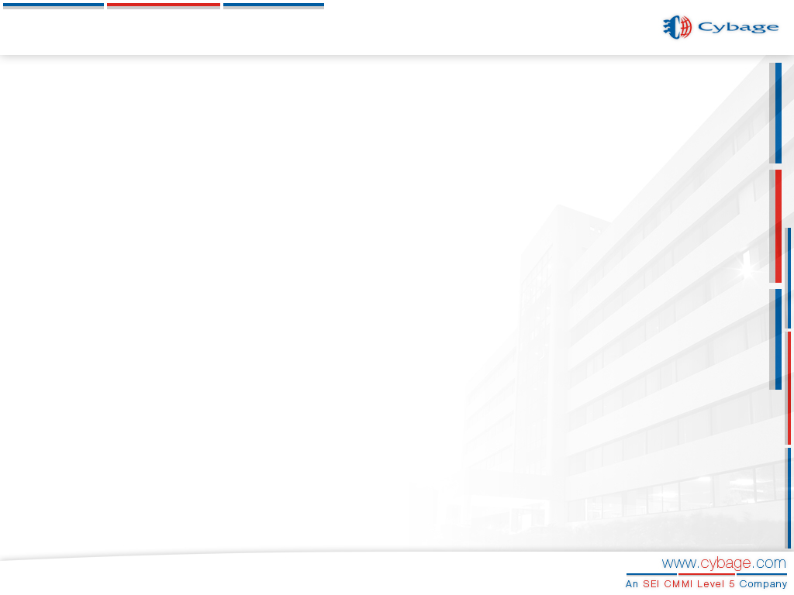
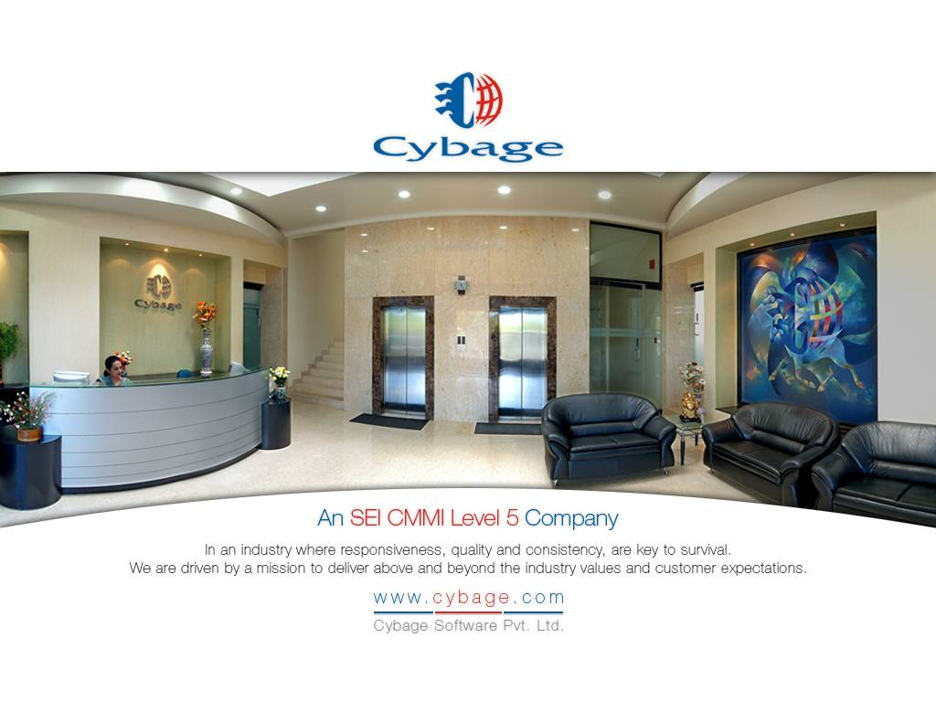

Slide 2
Automation using Selenium
Authored & Presented by : Chinmay Sathe & Amit Prabhu
Cybage Software Pvt. Ltd.

Slide 3
Agenda
  What is Selenium ?
      Selenium Components
      Advantages of Selenium
      Selenese-The language of Selenium
  Automating Tests using Selenium
      Prerequisites and Test Bed Setup
      Scripting Techniques and Best Practices
  Known Issues & Workarounds
  Benefits to Organization
  Drawbacks
  Selenium Reference on the Internet
      Source Repository
      Selenium User Forums
      Selenium Developer Forums
      Selenium-How to Contribute

Slide 4
What is Selenium ?

Slide 5
Selenium
Automation tool for web based applications
Used for functional regression testing
Uses JavaScript
Embeds test automation engine in your browser

Slide 6
Selenium Components
1. Selenium Core
Core engine of Selenium
JavaScript/DHTML library
Other Selenium components such as IDE and RC build on it
Supports a variety of platforms
    Windows: Internet Explorer 6.0 and 7.0 , FireFox 0.8 to 2.0
    Mac OS X: Safari 2.0.4+, FireFox 0.8 to 2.0 , Camino 1.0a1
    Linux: FireFox 0.8 to 2.0 Konqueror

Slide 7
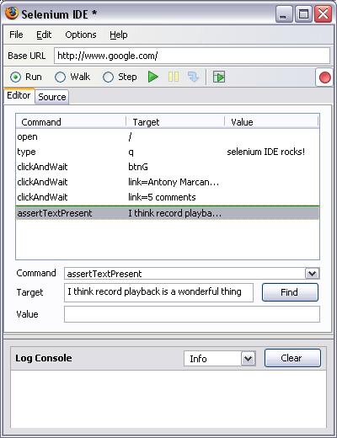
Selenium Components
2. Selenium IDE
Integrated development
environment for Selenium tests
Enables you to record a browser
session
Implemented as a Mozilla FireFox
extension
Allows you to record, edit, and
debug tests.

Slide 8
Selenium Components..
3. Selenium Remote Control (RC)
Provides Selenium Server
Start/Stop/Control supported browsers
Script web application UI tests
Works with any HTTP website
Uses any JavaScript enabled browser

Slide 9
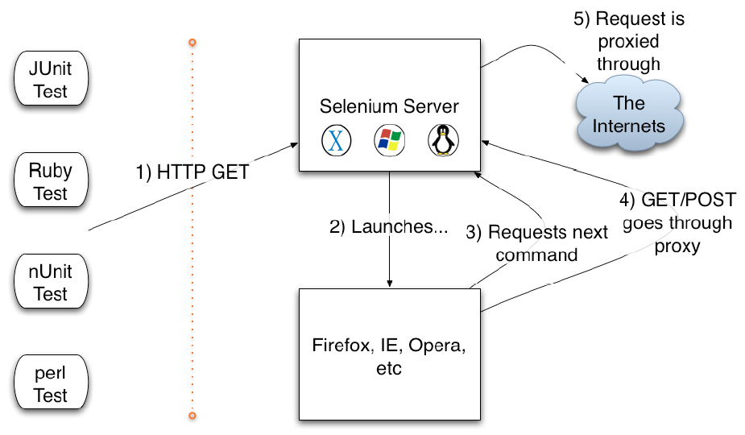
How Selenium RC Works

Slide 10
Advantages of Selenium
Open source, free software
Easy Installation
Scripting Techniques :
    Easy recording and playback of scripts
    Modular scripts
Compatibility :
    Multiple operating systems (Windows, Linux, Mac)
    Allows cross browser testing (Record in FireFox, execute in IE)
No dedicated machine required for test execution (user can work in parallel).
Integration with third party tools.
    Example : RTH Test Case Management Tool.

Slide 11
Selenese-The language of Selenium
Selenese consists of Actions, Accessors, Element Locators and Variables
Actions - Commands for the selenese language to perform a action on a web application
    Script performs a particular action
    Typically take element locator and possibly a value
    Examples :
1.Open- open a url
2.Click- click button, link, etc..
3.Type- type text in text field

Slide 12
Selenese-The language of Selenium
Accessors – Verification / Validation checkpoints for the tool
    Data related
    Take only element locators
    Examples :
1. store(locator,variable)
2. verify(locator,pattern)
3.eval- return value of JS expression
4. bodyText-contents of HTML body

Slide 13
Selenese-The language of Selenium
Element Locators
These can be id, name, identifier, link, etc..
Variables used in scripting
  Information regarding Actions, Accessors can be found in class ‘Selenium Driver’ in installed directory
  For e.g. C:\Selenium\selenium-remote-control-0.9.0\ruby\doc\index.html

Slide 14
Sample Script
require "selenium"
require "test/unit"
def test_new
@selenium.open "/"
@selenium.type "q", "Hello"
@selenium.click "btnG"
@selenium.wait_for_page_to_load "30000"
begin
assert @selenium.is_text_present("Hello is a new way to look at pictures with friends and family. )
rescue Test::Unit::AssertionFailedError
@verification_errors << $!
end
temp = @selenium.get_text("//div[2]/div[1]")
end
end

Slide 15
Automating Tests using Selenium

Slide 16
Prerequisites and Test Bed Setup
Software :
    Selenium IDE, Mozilla FireFox for script recording
    Selenium Server, Java for running scripts
Configuration :
    Set path variables
    Use –multiWindow option while starting server
Resource :
    Users… should have basic scripting knowledge
    Hardware… No specific requirement the basic configuration for a server – P4, 512 MB RAM is good enough.

Slide 17
Scripting Techniques and Best Practices
In order to ensure the quality of scripts and reduce maintenance, it is best to have scripting techniques and best practices. Some of which are…
Comments and proper formatting in scripts
Scripting considerations for integration with other tools
Documentation of basic data required for scripts
Documentation of new functions added for scripts
Follow fixed, logical scripting format
Include code to handle Selenium errors
Scripting according to application specific issues

Slide 18
Known Issues & Workarounds

Slide 19
Elements not found on page
Potential Causes :
    Can happen due to execution speed of Selenium
    Elements do not load on page in time
Fix :
    Add code in scripts which waits for elements
Additional issues :
    Sometimes existing elements on a page are not detected
    Sometimes elements on a page have a same label
Solution :
    Obtain exact element label from source code
    Label can be used in scripts for accuracy

Slide 20
Handling of Popup windows
Steps :
    Window id required for automated operations in window
    At times if id is not obtained during recording, go to window and perform operations
    Window id will be obtained after this action.

Slide 21
Handling of Frames
Option :
    -multiWindow option handles potential frame problems
Causes :
    At times required name of frame not obtained in recording
Fix :
    Obtain frame label from source code
    Also can be obtained from browser URL bar

Slide 22
Benefits to Organization

Slide 23
Benefits to Organization
Automation Benefits :
  Usual benefits for automation e.g. Time saving
    Time required for sanity reduced ( 12 man hours to 3 man hours, build frequency of 4-5 builds a month )
    For one of the projects, Sanity suite automated : 243 test cases
  Good Returns on Zero Investment
Increasing Productivity
    Cost saving as it is open-source
    QA engineers get familiar with scripting languages like Ruby, Perl etc apart from manual testing
Caveat:
    Full automation and maintenance has not been evaluated and that can be a risk

Slide 24
Drawbacks
Lack of exhaustive formal guidance material
Mozilla FireFox browser is required for script recording
Only works with web based applications

Slide 25
Selenium Reference on the Internet

Slide 26
Selenium Source Repository
View : http://svn.openqa.org/fisheye/viewrep/selenium-core/trunk
To check out Selenium Core: svn co https://svn.openqa.org/svn/selenium-core/trunk

Slide 27
Selenium User Forums
Selenium Core http://forums.openqa.org/forum.jspa?forumID=3
Selenium IDE http://forums.openqa.org/forum.jspa?forumID=2
Selenium RC http://forums.openqa.org/forum.jspa?forumID=13

Slide 28
Developer Forums
http://forums.openqa.org/forum.jspa?forumID=4
Post suggestions, feature requests, patches, etc..
Development mailing list : selenium-core-dev-subscribe@openqa.org
Send emails in plain text format only

Slide 29
Selenium –How to Contribute
QA/User Contribution :
Submit bug reports , with patches
Helping out in forums
Development :
Becoming a regular Selenium developer is on invite-only basis

Slide 30

Questions
Thank You !!!

